Slide 1
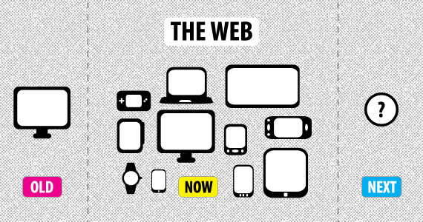
Responsive Web Project
Source: ©2013 http://www.onbile.com/info/wp-content/uploads/2013/03/responsive-web-design.jpg

Slide 2
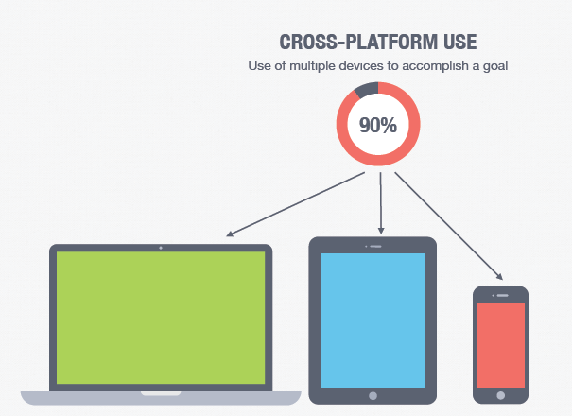
Objectives
a best in class website that is easy-to-use on any device, and
30+ online transactions which link to business IT systems
Customer log-in area

Slide 3
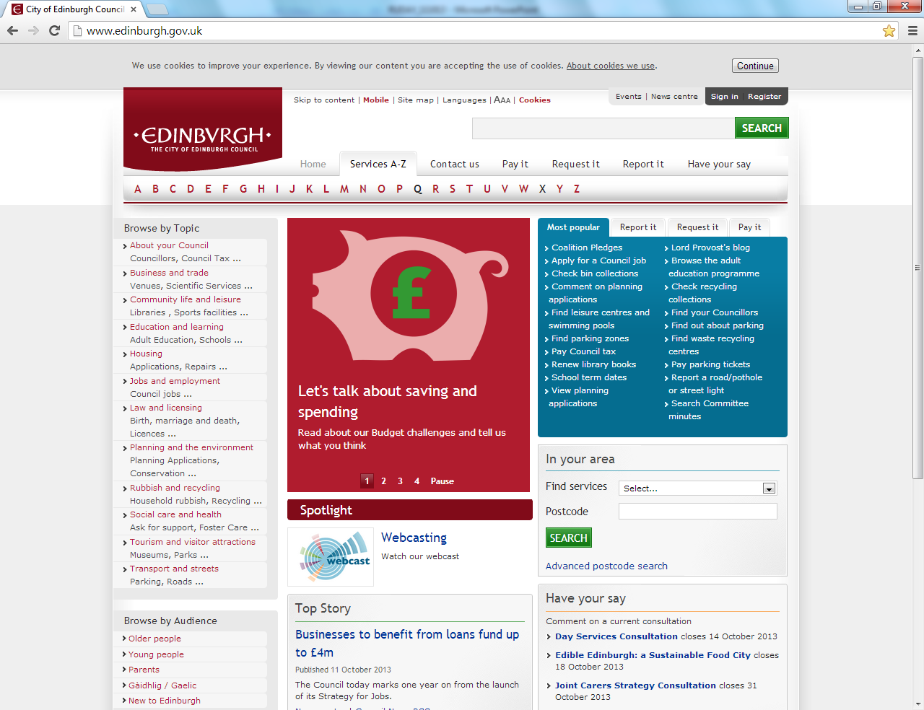

Slide 4
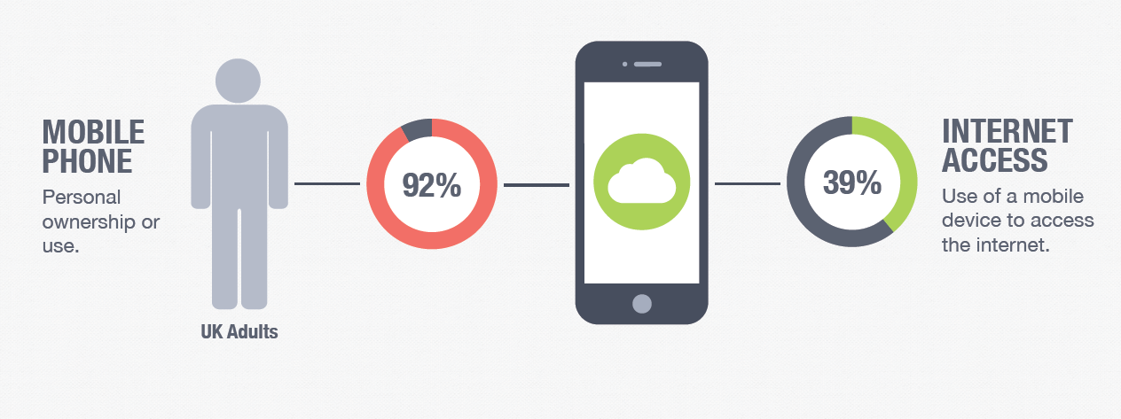
Our expectations of the Web are changing

Slide 5
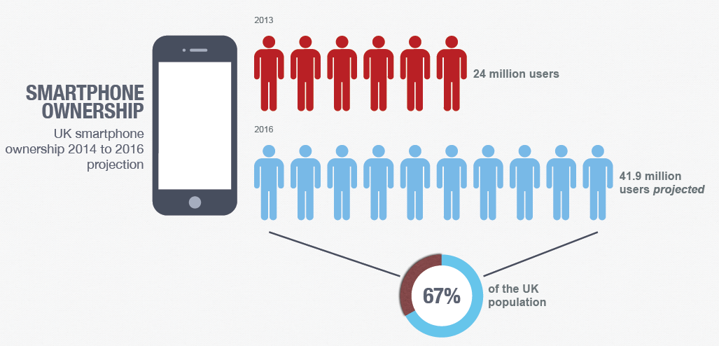
Notes:
5

Slide 6
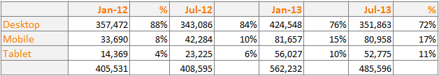
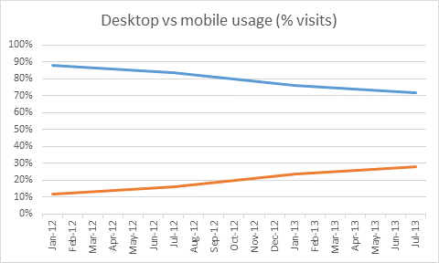
Visits to the Council website
Desktop
Mobile
Source: Google Analytics – CEC /info/ directory

Slide 7
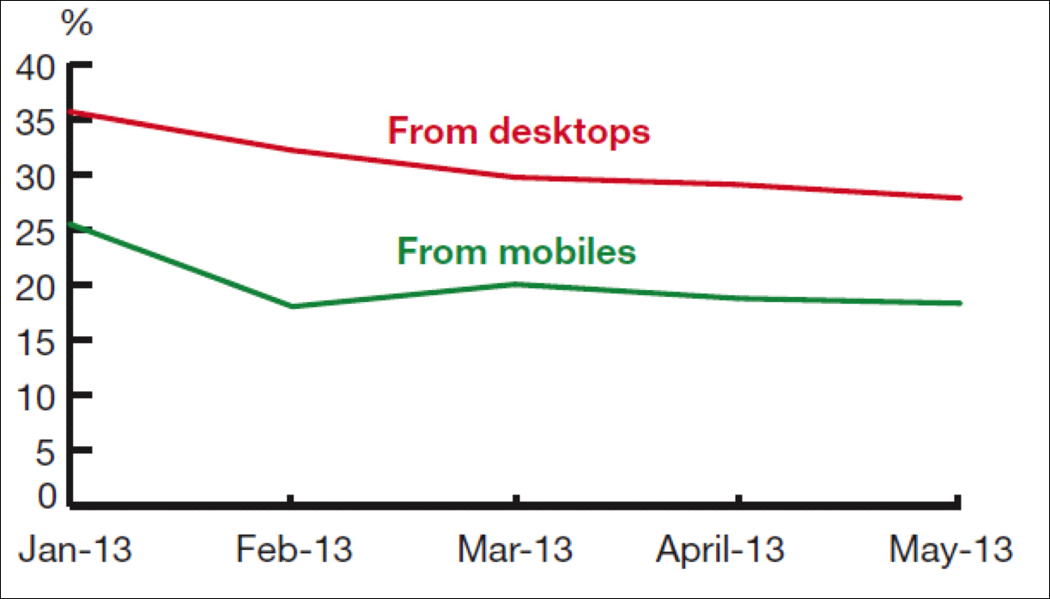
Mobile has changed the web
Source: Mobile vs Desktop Failure Rates SOCITM, June 2013

Slide 8


Slide 9
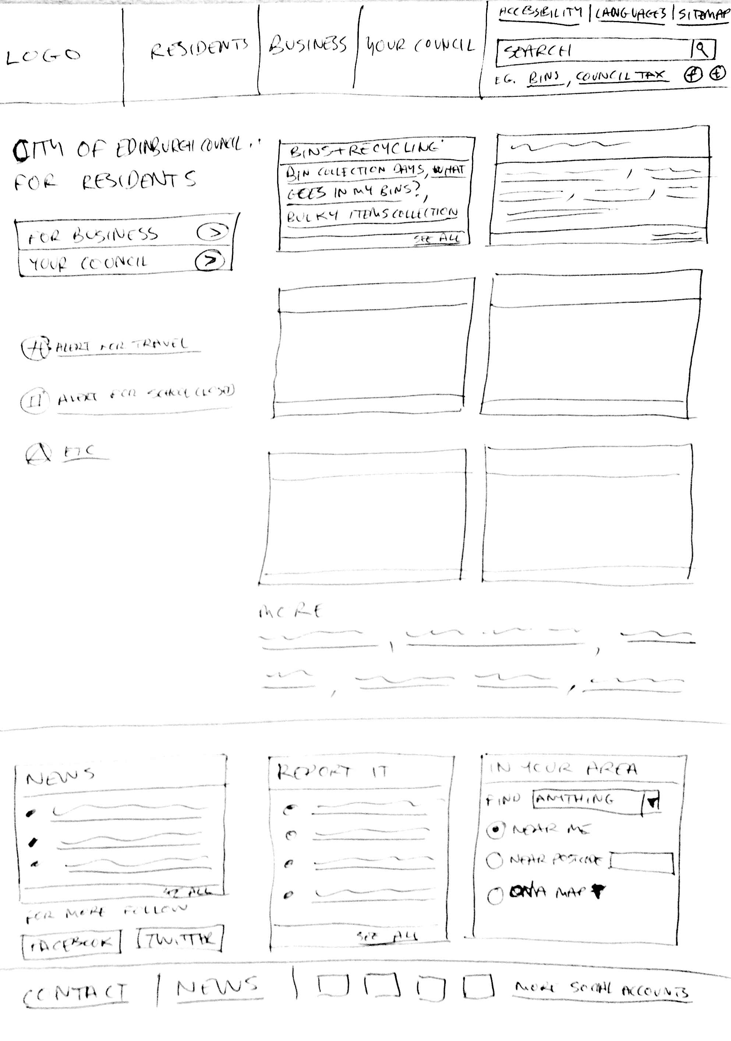
Paper Prototypes
Iterative development

Slide 10
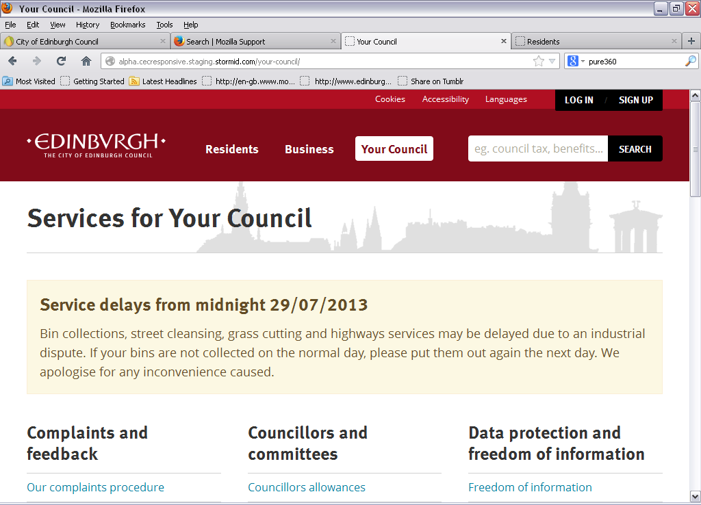

Slide 11
http://cec.stormid.co/
Alpha site 31 August

Slide 12
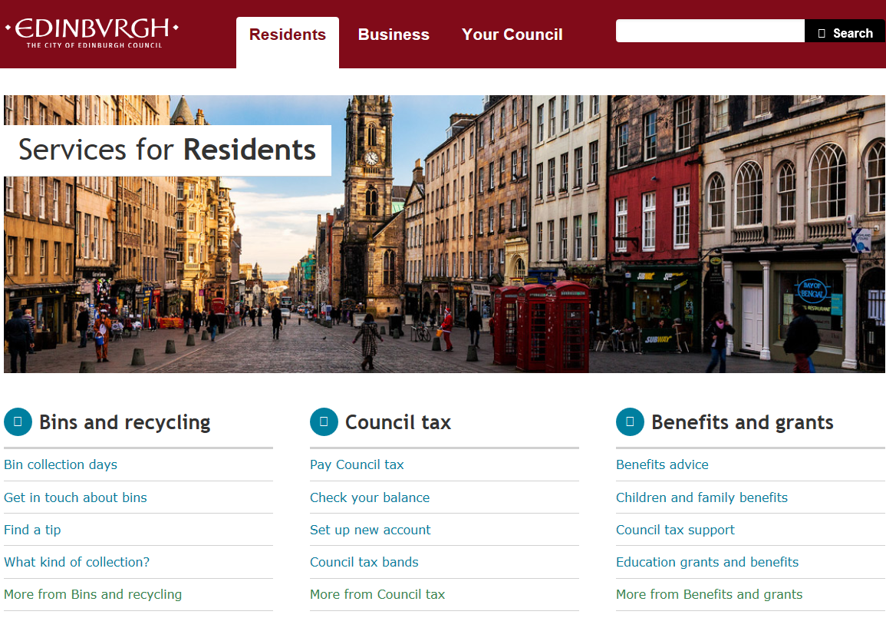
Mobile friendly content
3 sample forms
Clean and simple design
Top tasks first

Slide 13
Content Approach
Design principles & best practice
Gov.uk
Statistical analysis
Key words
Page visits
Re-use good work from other councils
Content types
Copywriter – iterative process
Populate Alpha site

Slide 14










ICT&D Stakeholders
Empowered Citizens
Empowered Visitors
and Students
Empowered Partners
Citizens Focus groups
based on segmentation
analysis
Analysis from Edinburgh
People’s Survey
Edinburgh Partnership
Executive
NHS Lothian
Survey with visitors
Visit Scotland
Focus group with Students
Empowered Management
Empowered Elected Members
Empowered Workforce
ICT and Digital Board
Extended CMT
Senior Management Teams
Directorate ICT and Digital
Boards
Elected Member ICT Sounding
Board
Elected Member
Open Day
Focus groups with each directorate
Employee Survey 2012
ICT Survey
ICT Open Day
Empowered Learners
Empowered Businesses
ICT and Digital Leads
Research from Learning
and Teaching refresh
Head Teachers ICT project
group
Business Gateway
Survey with
local Businesses

Slide 15
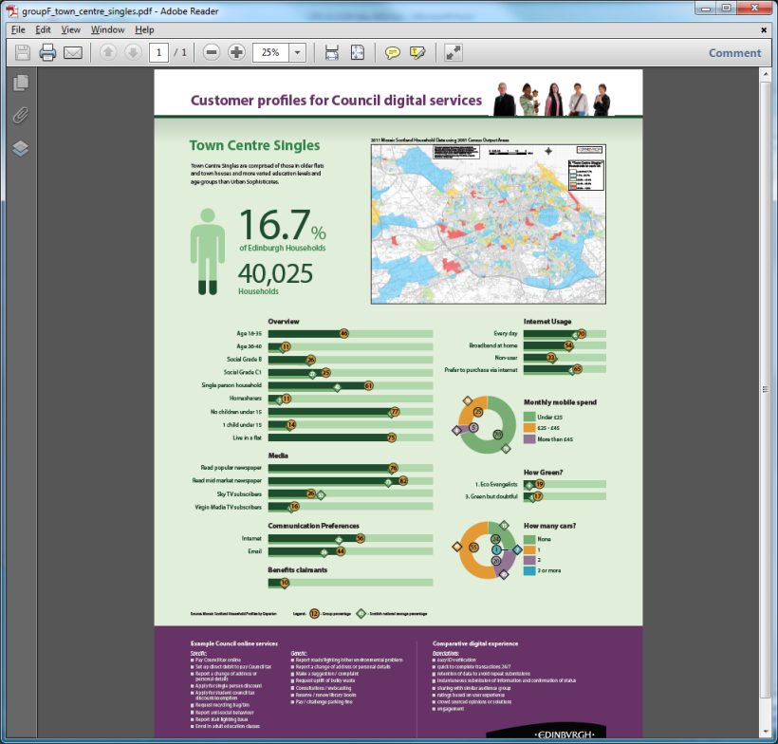
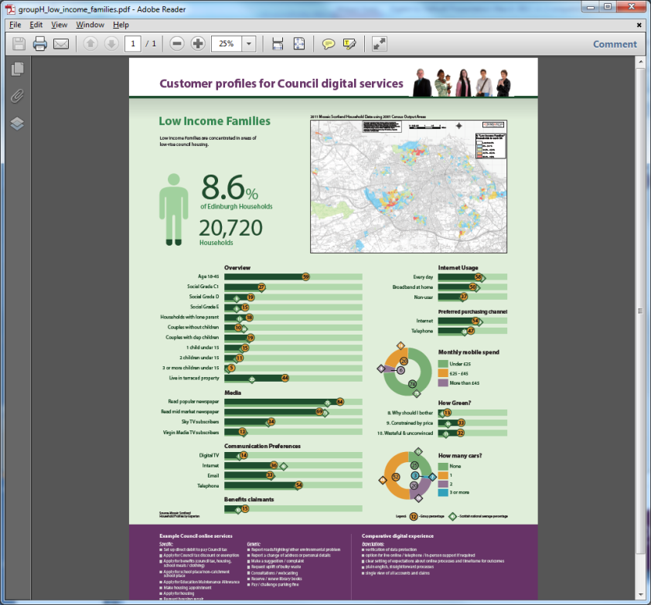
Scope

Slide 16
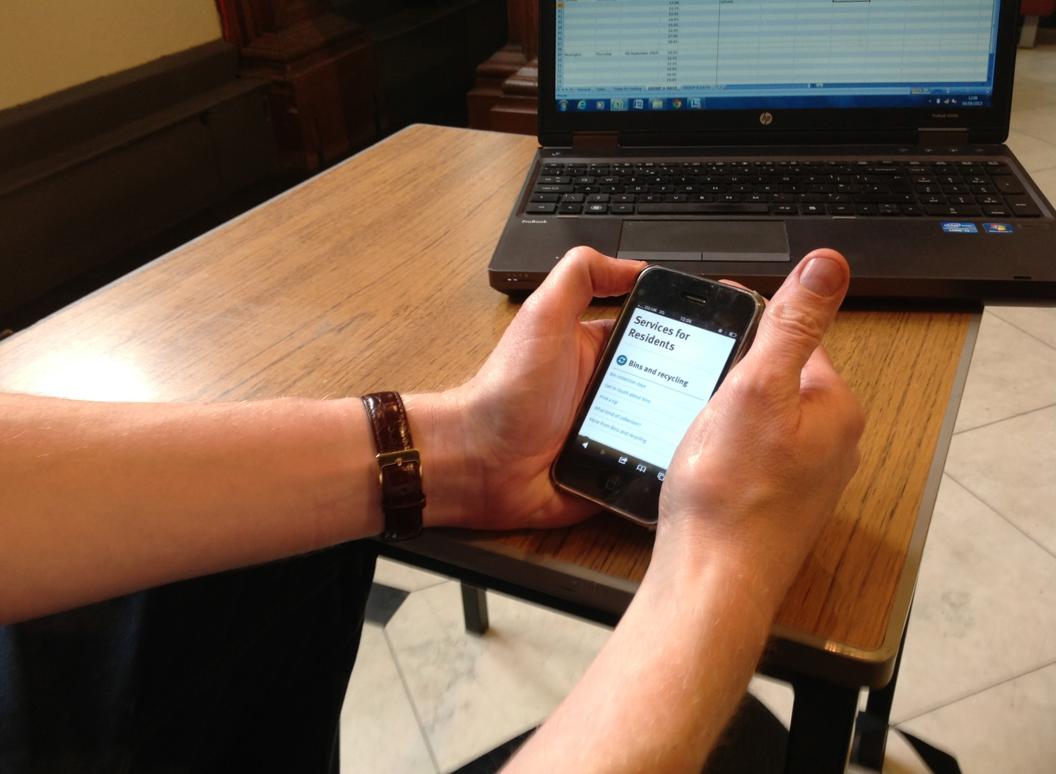
Approach – general public
>Sampling general residential population of Edinburgh
>1-1 observational feedback
>Not general release

Slide 17
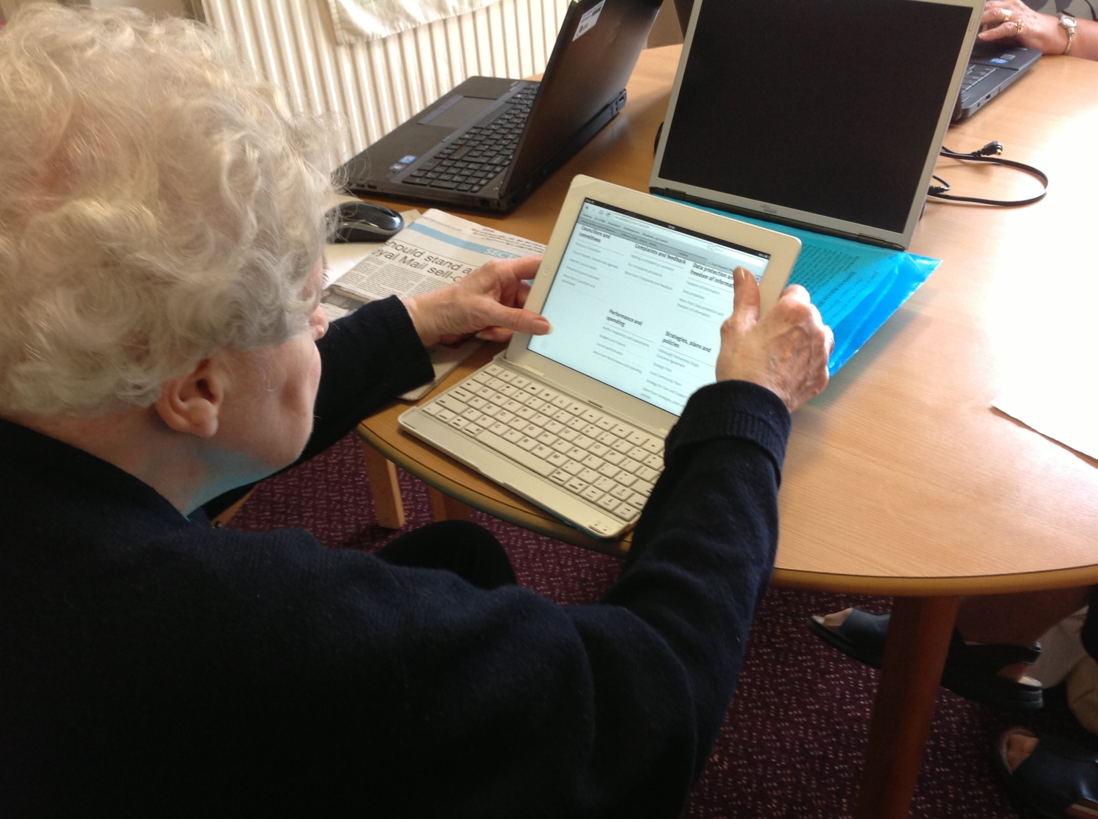
Approach – interest groups
Not general release
1-1 observational feedback
Sampling general residential population of Edinburgh
Plus specific interest groups
>Special interest groups
>1-1 observational feedback and group discussion

Slide 18
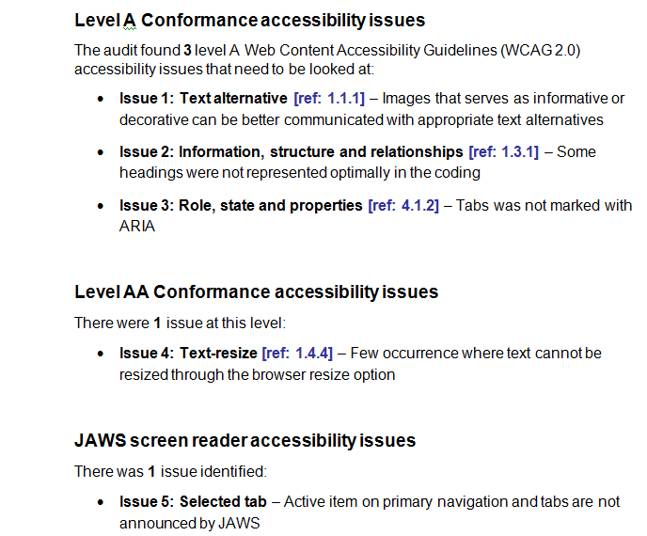

Approach – accessibility

Slide 19
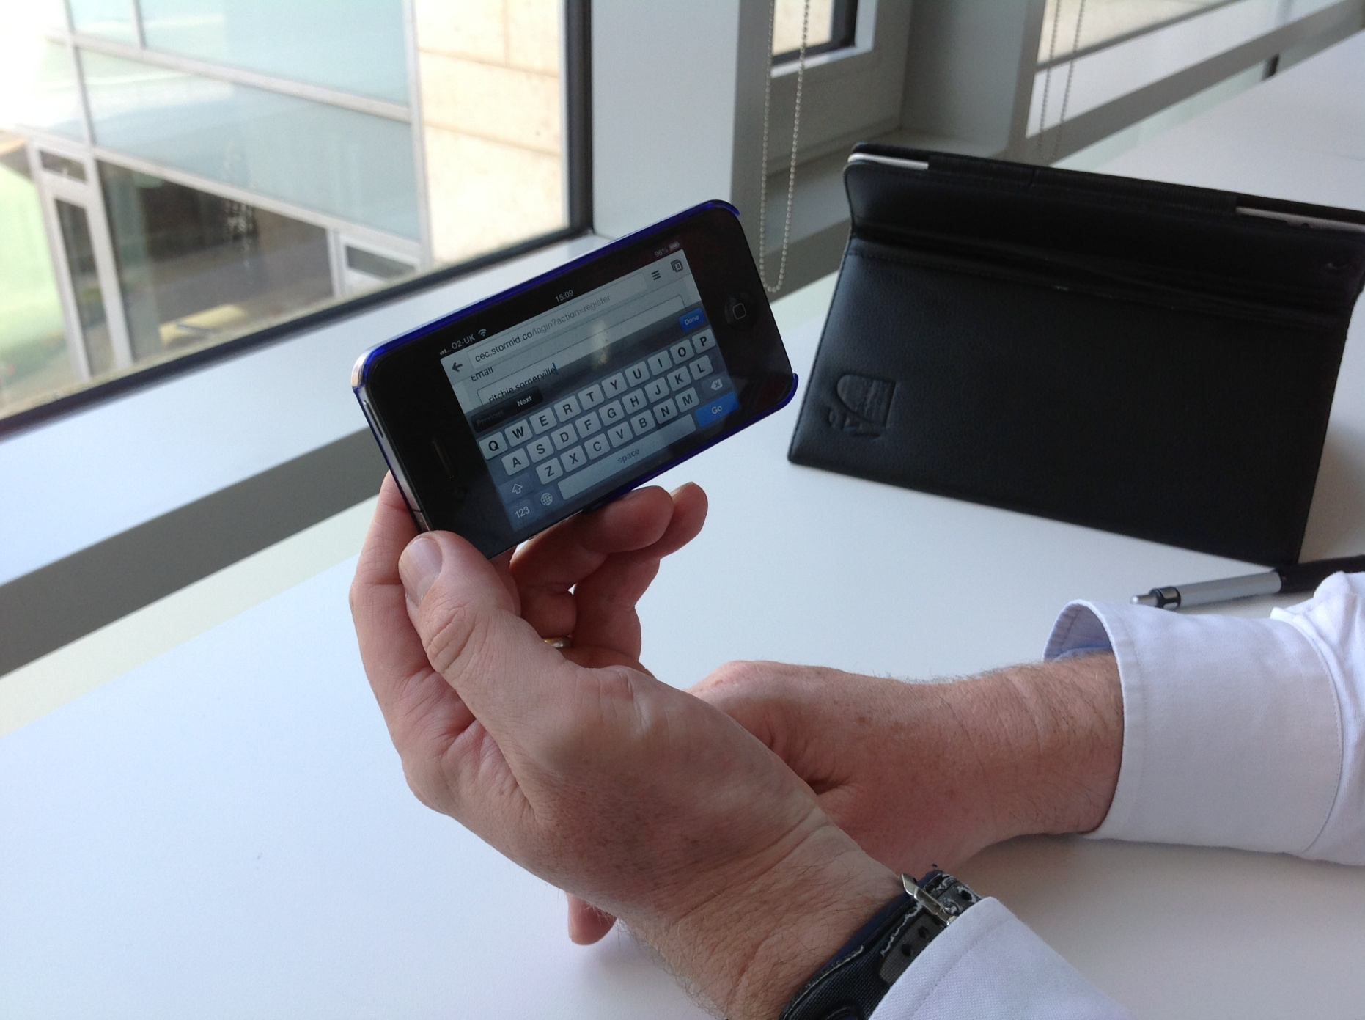
Approach – internal stakeholders
Approach – inrnal stakeholders

Slide 20
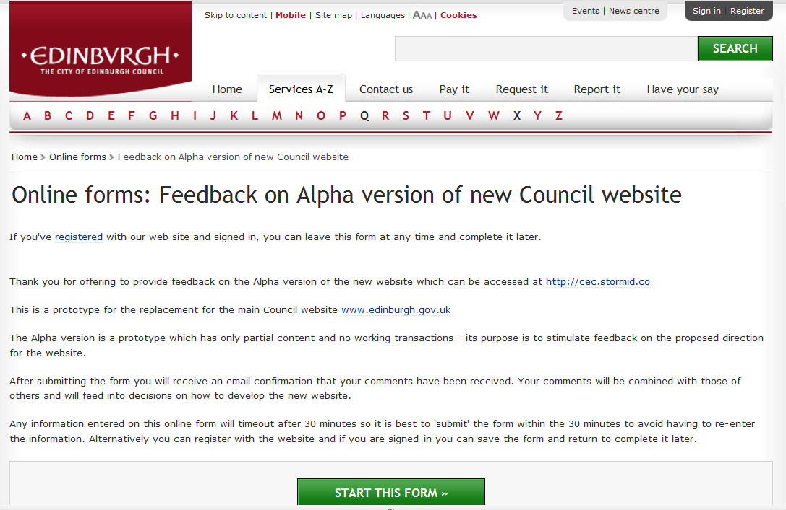
Approach – internal stakeholders

Slide 21
Approach – selection of tasks
Cover a range of content and function types
Article
Recycling box contents, skip permit, petition form
Guide (personalised information)
My Edinburgh, bin collection days
Transaction
Set up Council tax, report fly tipping
Signpost
Find out about composting
Directory search
New business events, bin collection days
Audience split
New business events, skip permit, pay business rates, make a complaint, petition form, find councillors
Contact information
Make a complaint, apply for a school place, contact Social Care

Slide 22
Popular categories
Top mobile/tablet tasks
Recycling box contents
School term dates
Find out about
composting
Request a red recycling box
Look for jobs with the Council
Find bin collection days
Pay parking fine
Set up Council tax
Comment on planning
application
Report fly tipping
Make a complaint online
Priority tasks for 2013-14
Notes:
.

Slide 23
Summary questions
Does the three audiences split make sense?
Do you like the icons?
Do you want to see the Council’s Twitter feed?
Do you agree with the reduced prominence of news?
General impressions of the site?

Slide 24
DESIGN
IA
Presentation of top tasks
‘Audiences’: Residents, Business, Your Council
How is this best done?
Retain, replace, drop?
COPY
FUNCTIONALITY
Cross-linking/contact info
‘My Account’
How is this best done?
What is essential ‘go-live’ content?

Slide 25
Overall impressions
"A big improvement on the original one. The way it's set out like that, it's a lot more user friendly than the list one that's just full of links."
"I think my view on the new site is it's a very up to date one, twenty-first century kind of thing. Changing with time. I like it. Encouraging more people to use it.”
"I like it. It's a lot smoother to look at than the old one. It looks more modern and contemporary.”

Slide 26
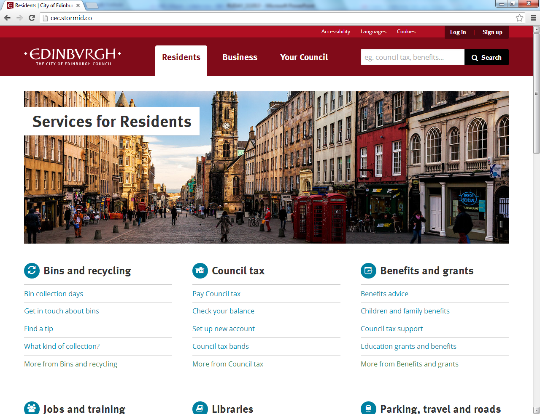

Slide 27
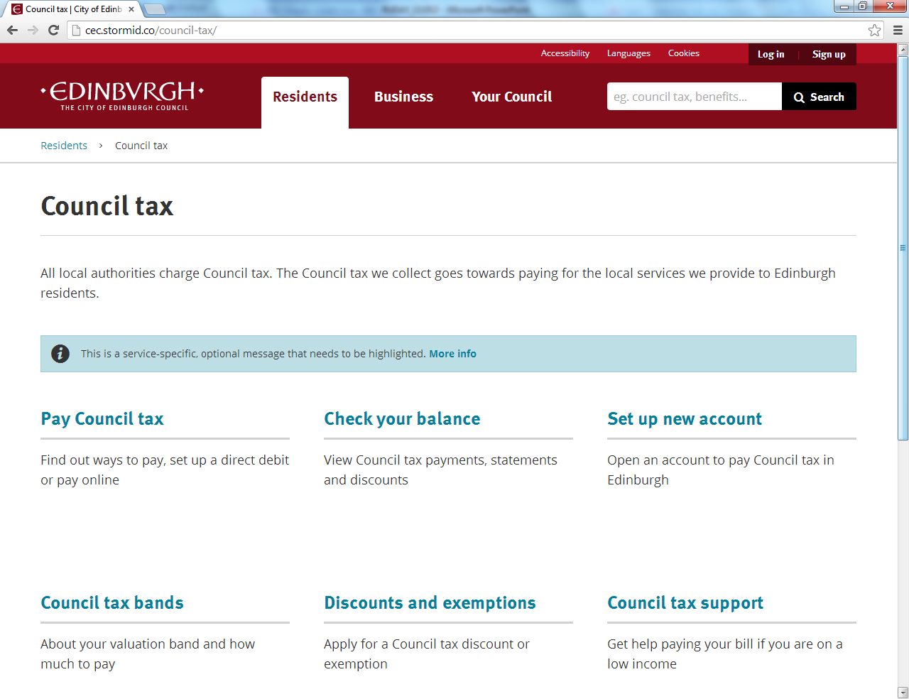

Slide 28
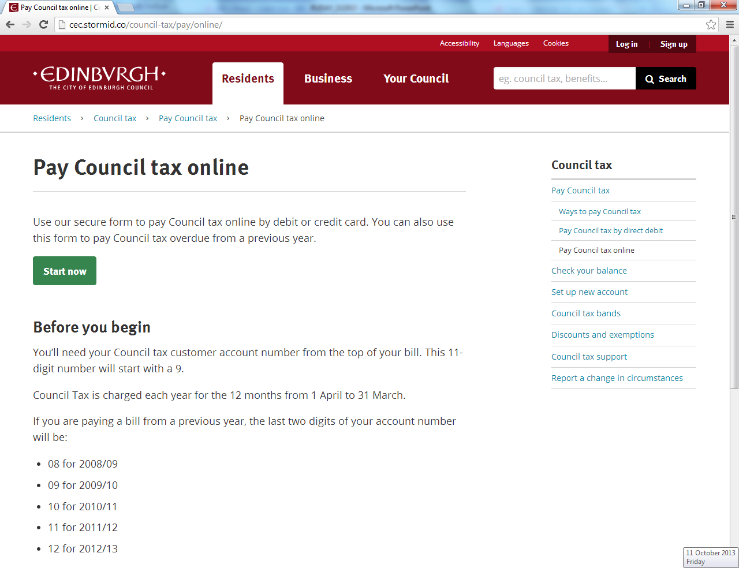

Slide 29
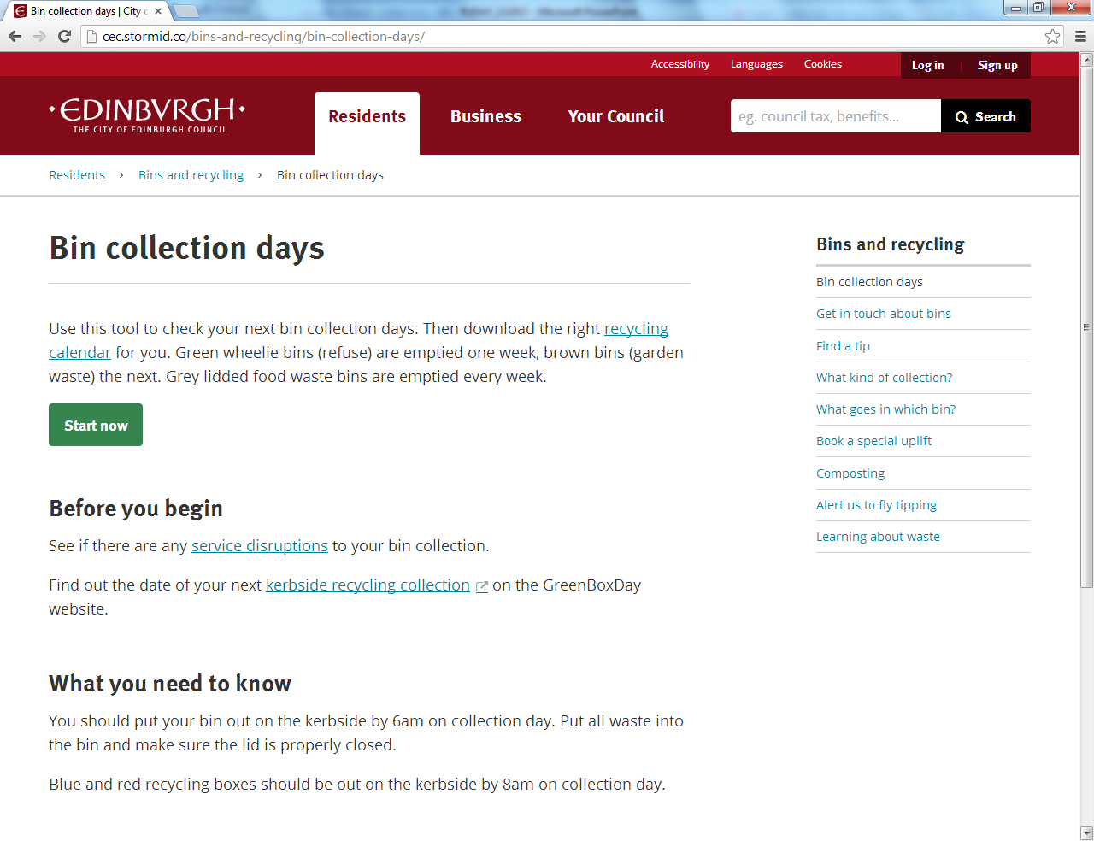

Slide 30
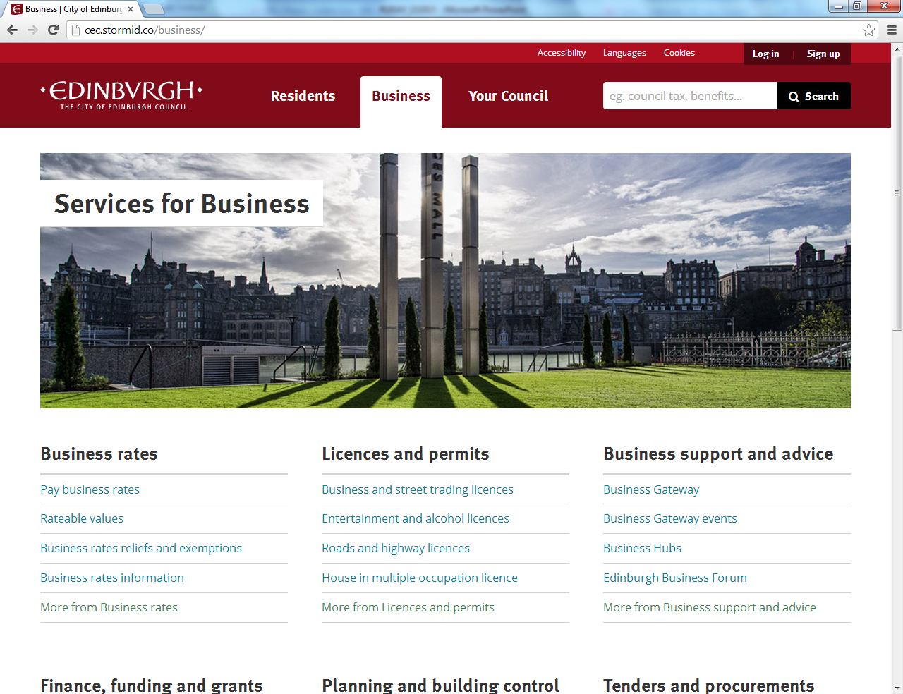

Slide 31
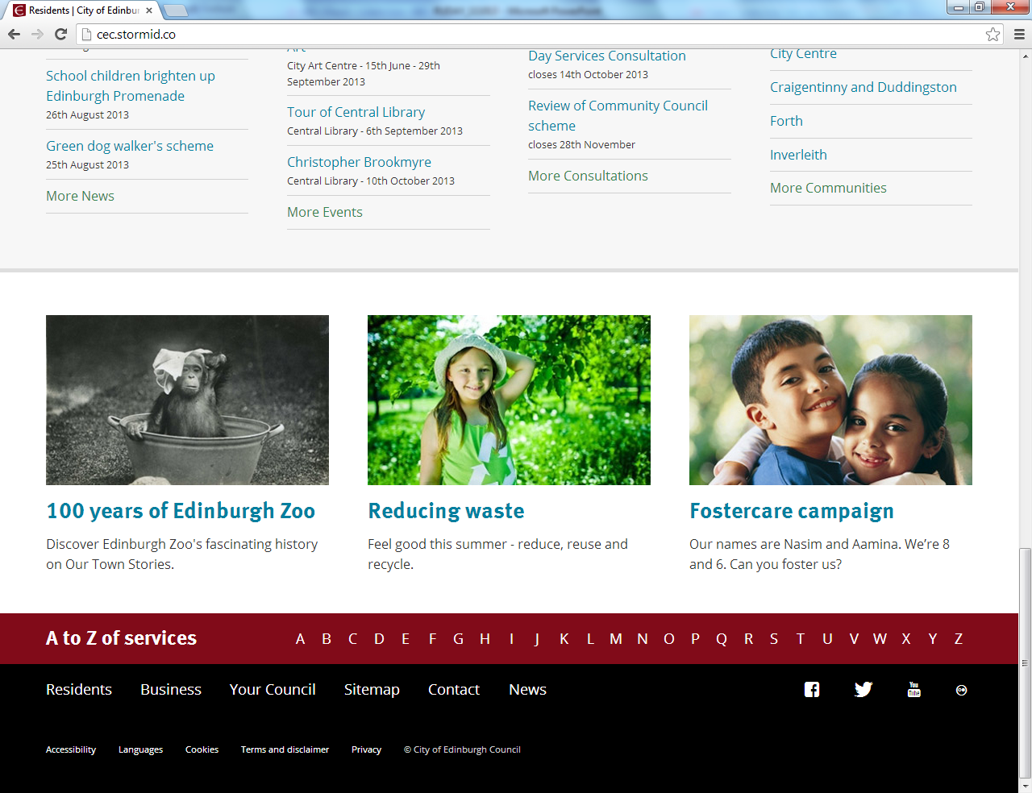

Slide 32
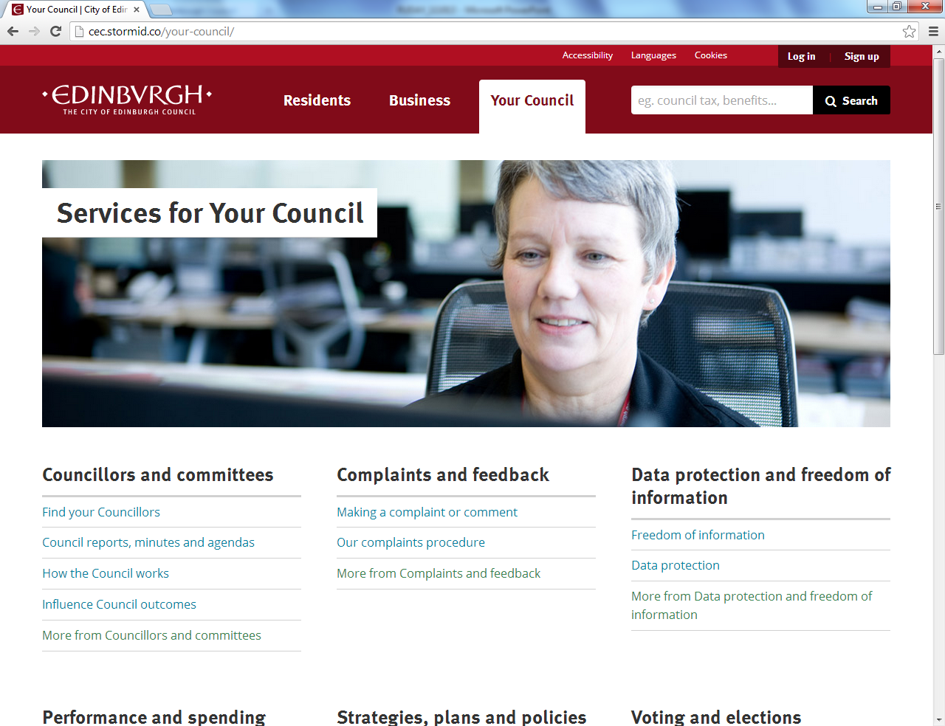

Slide 33
Example quotes about issues
“Why don't you have a section for schools and learning? You have bins first?”
“I guess that's what the council's for - bins and council tax and things - but I think knowing other things that they do that you have no clue would be nice, that they're doing for our community.”
Design: Task Priorities
“I want to know about services for everybody. I want to report litter in the street, but am not a resident. I use libraries and am interested in jobs and training; these are definitely not for residents only. And what about visitors?”
IA: Categories

Slide 34
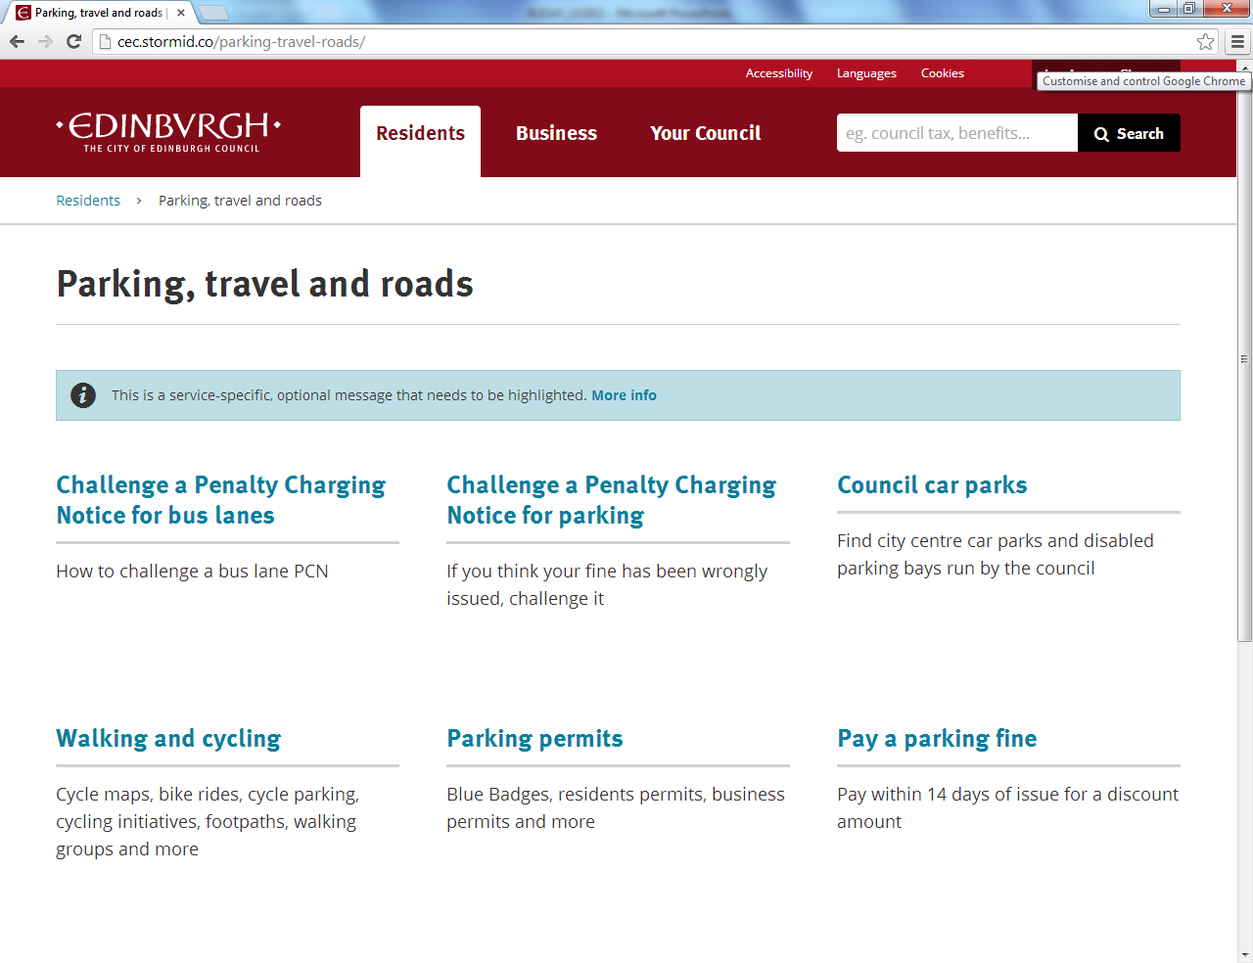

Slide 35
Sally Kerr
Council Web and Digital Manager
@WeeBletherer
sally.kerr@edinburgh.gov.uk

